Slide 1
BACTERIAL Colonial MORPHOLOGY
Prepared by
Lecturer Reham M.M. AL-Mosawi
Microbiology (Medical bacteriology)

Slide 2
BACTERIAL COLONY MORPHOLOGY
A colony is defined as a visible mass of microorganisms all originating from a single mother cell, therefore a colony constitutes a clone of bacteria all genetically alike. In the identification of bacteria and fungi much weight is placed on how the organism grows in or on media.
This exercise will help you identify the cultural characteristics of a bacterium on an agar plate---called colony morphology. Although one might not necessarily see the importance of colonial morphology at first, it really can be important when identifying the bacterium.
Features of the colonies may help to pinpoint the identity of the bacterium. Different species of bacteria can produce very different colonies.

Slide 3
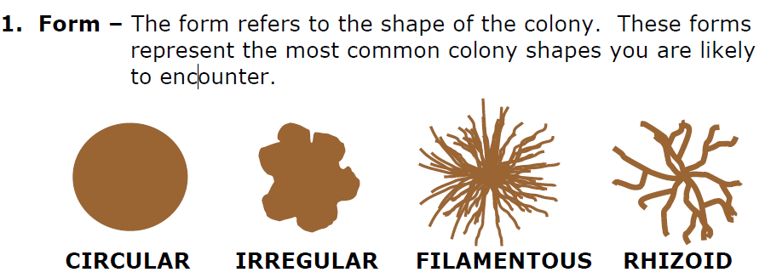
BACTERIAL COLONY MORPHOLOGY

Slide 4
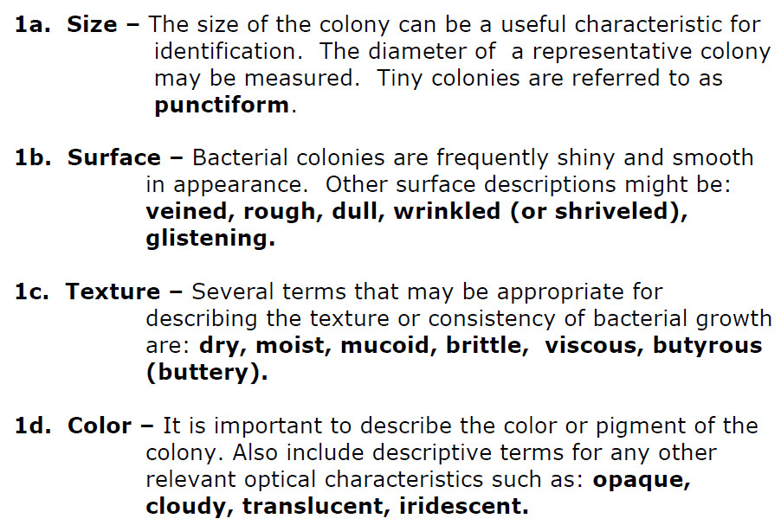
BACTERIAL COLONY MORPHOLOGY

Slide 5
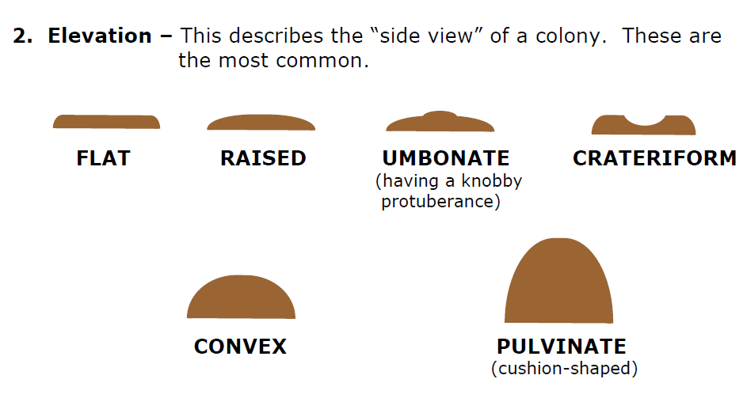
BACTERIAL COLONY MORPHOLOGY

Slide 6
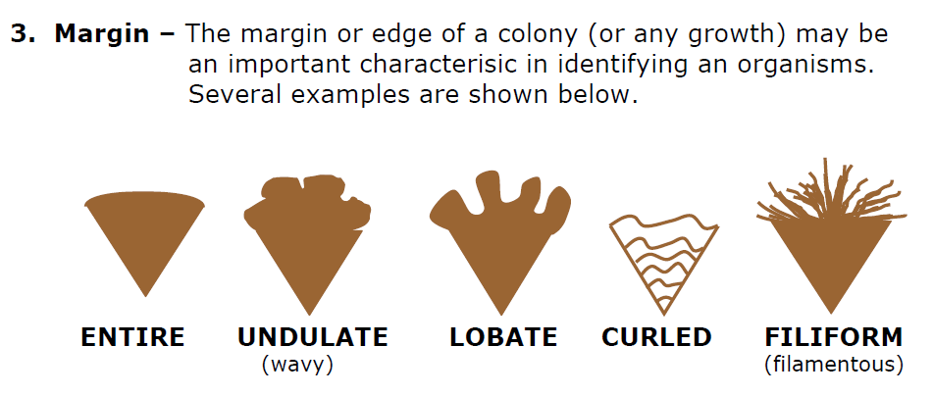
BACTERIAL COLONY MORPHOLOGY

